Slide 1
30th November
2024
Drone Detection and Neutralization
Supervisor
TEAM MEMBERS
Dr. Amit Shukla
Ayush Kumar Singh (B21283)
Akash Kumar (B21272)
Atharva Ayanar (B21282)
Ritik Rajput (B21220)
Major
Technical
Project
Faculty Advisor
Dr. Prateek Saxena

Slide 2
REVIEW PROBLEM STATEMENT
30th November
2024
To detect drones or UAV’s (Unmanned Aerial Vehicles) and find or create an effective method to neutralize them
Objective: This project focuses on the detection and neutralization of unauthorized drones using innovative approaches. The primary objective is to secure airspace from potential threats posed by drones.
2
2
Notes:
OBJ- Develop a system capable of detecting unauthorized drones and neutralizing potential threats in real-time.
Imp-
--> In the defence, for sending supplies in flood affected areas,
various delivery systems
-->Securing critical infrastructure
Preventing unauthorized surveillance
Protecting public events and restricted zones

Slide 3

REVIEW PROBLEM STATEMENT
30th November
2024
Industrial Applications:
Drones are increasingly used for various types of legitimate purposes but can also pose serious security risks.
Detecting and neutralizing drones in real-time is critical to prevent threats to privacy, infrastructure, and public safety.
Need for Visual Detection:
Drone-mounted cameras enable accurate identification in complex environments.
Reliable detection is essential for future integration with air-to-air neutralization.
3
2

Slide 4
Current Semester Focus
Develop an accurate drone detection system using visual detection techniques.
Dataset Creation: Captured air-to-air images by flying two drones, forming a custom self-built dataset.
Model Training: Trained and optimized advanced machine learning models (YOLOv8 and YOLOv9) using added optimizers such as Adam, Adagrad, and SGD, alongside hyperparameter tuning, to enhance real-time drone identification.
Testing: Evaluated the models on various types of drones available, collecting performance results for precision and recall.
Lay the groundwork for air-to-air neutralization in the upcoming semester, where one drone intercepts another.
30th November
2024
4
2

Slide 5
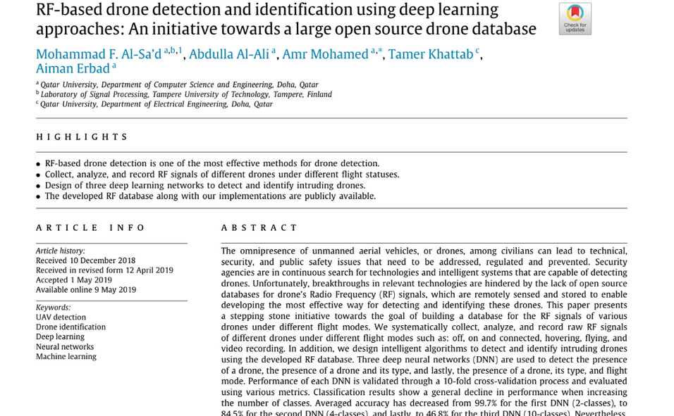
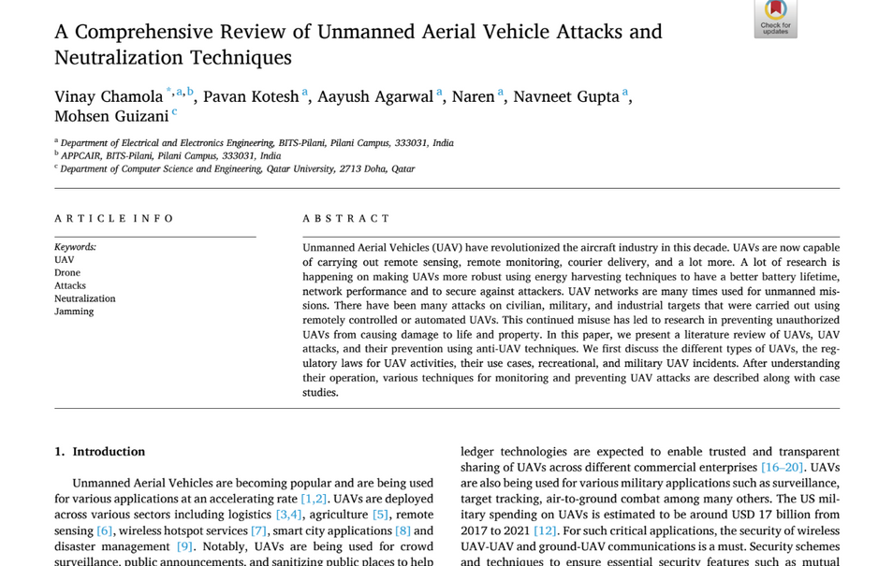
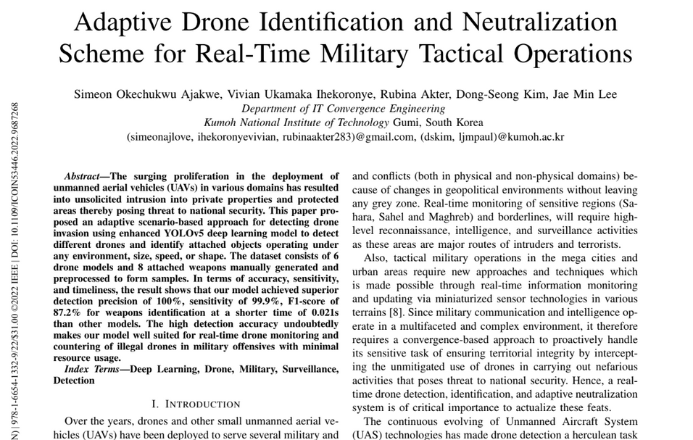
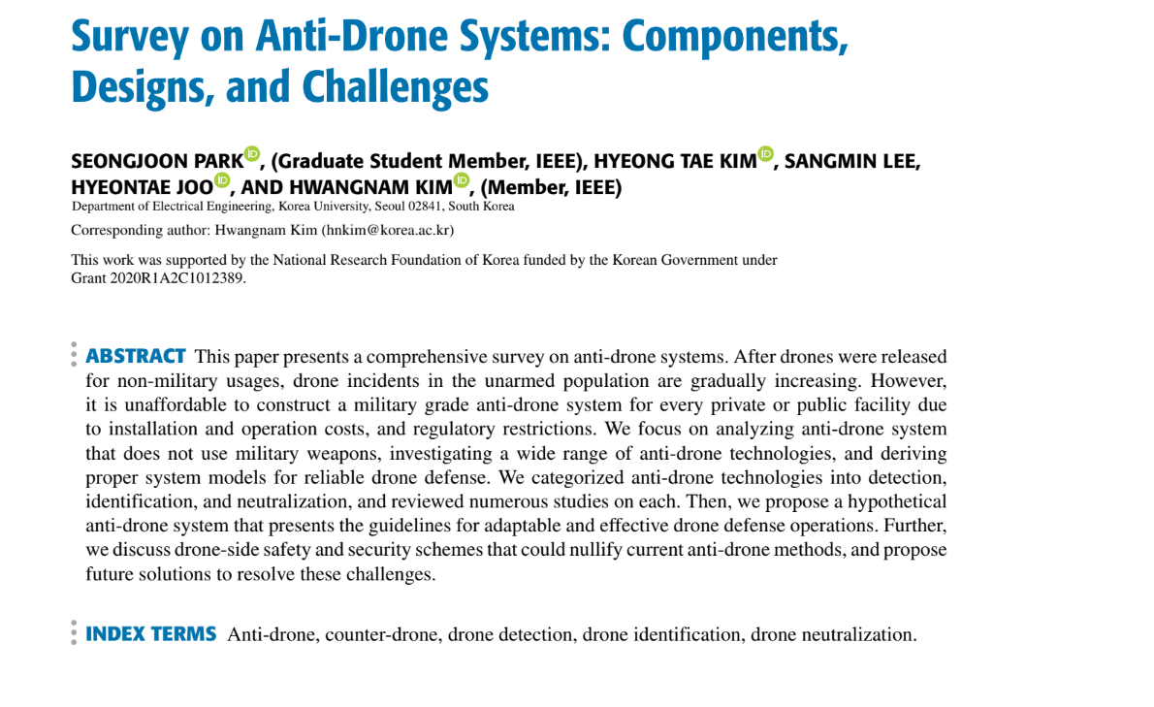
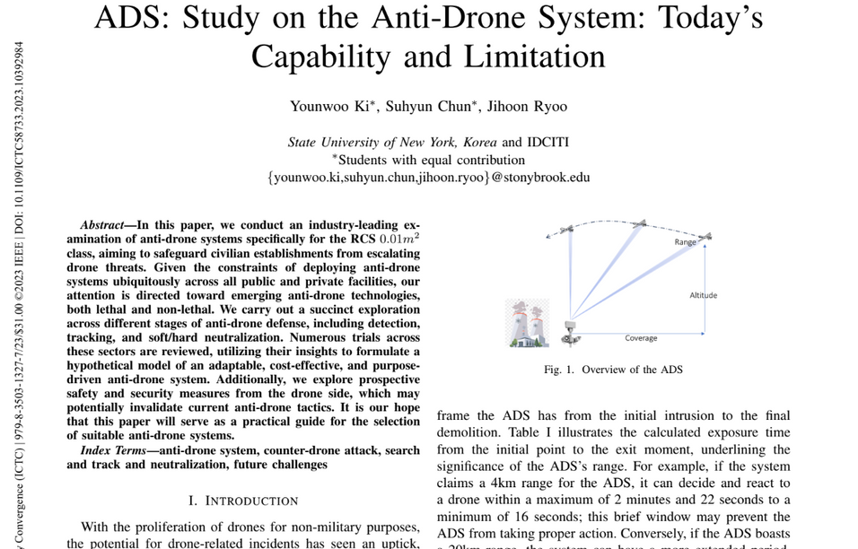
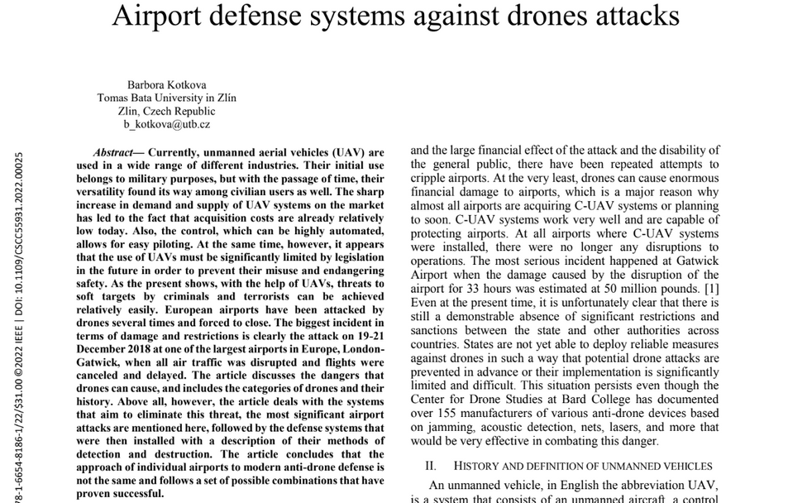
I
PREVIOUS WORKS
20+ papers reviewed and compared multiple models and techniques for detection and neutralization
30th November
2024
Source:Research papers mentioned in last
5
2

Slide 6
Methods of Detections of Drones
30th November
2024
While going through the literature review and searching on the internet we came across multiple methods of detection. Visual detection seemed one of the reliable methods we came across so we went on with this method for our project
1. Optical Detection
2. Acoustic Detection
3. Radio Frequency (RF) Detection
4. Radar Detection
5. Infrared Detection
6
2

Slide 7
WORKFLOW AND PLAN OF ACTION
LITERATURE REVIEW TO LEARN ABOUT EXISTING DETECTION AND NEUTRALIZATION METHODS
30th November
2024
CREATE THE TRAINING DATASET WITH DIFFERENT ANGLES VIEW FOR QUICK AND ACCURATE DETECTION, PREPROCESSING OF DATASET WITH VARIOUS AUGMENTATION TECHNIQUES
ADD OPTIMIZERS AND HYPERTUNE PARAMETERS TO TRAIN ADVANCED LEARNING ALGORITHMS TO ENHACE DRONE DETECTION
EVALUATE THE MODEL’S PERFORMANCE AND COLLECT RESULTS AND ANALYSIS
RESEARCH ABOUT DRONE NEUTRALIZATION TECHNIQUES
7
2

Slide 8
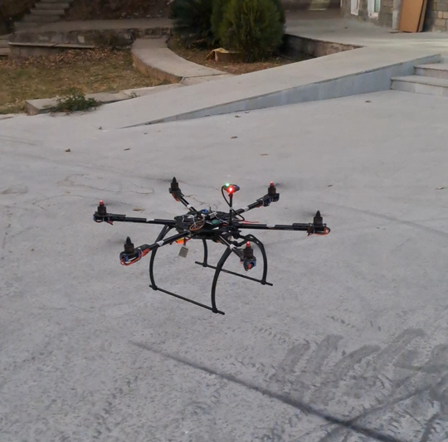
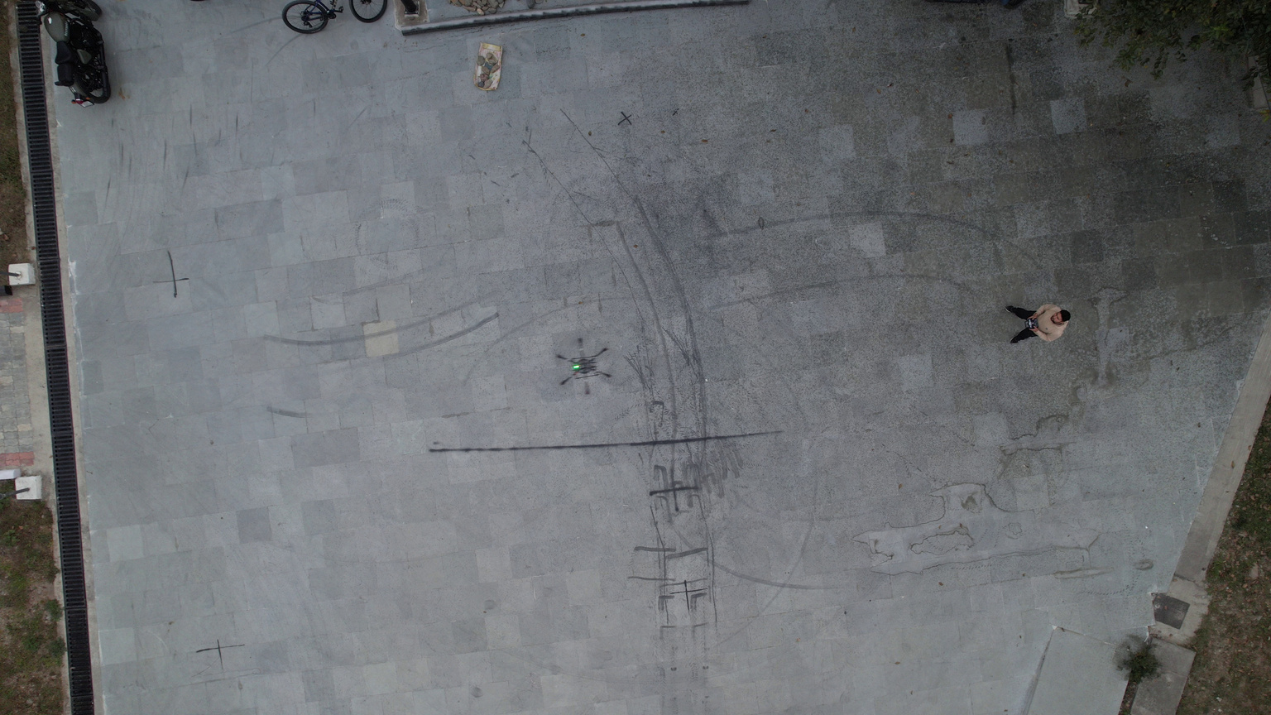
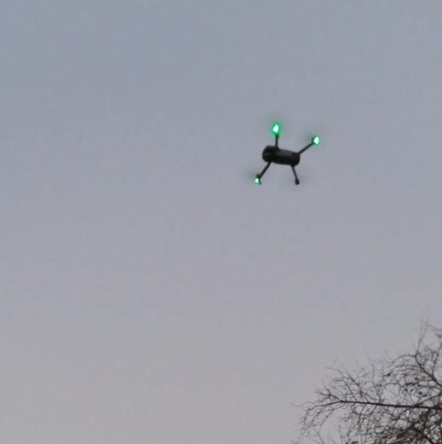
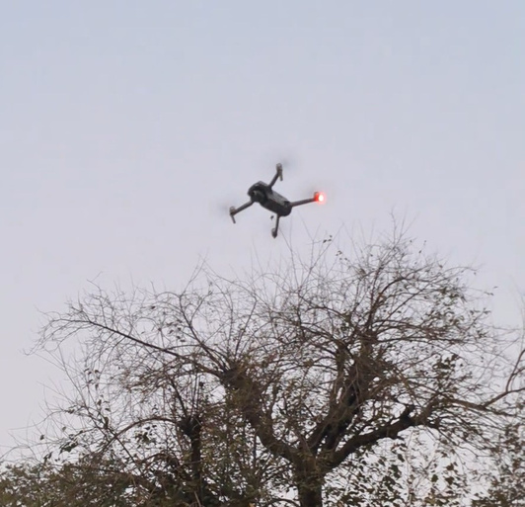
DATASET CREATION
Visual Example
30th November
2024
Captured Drone
Capturing Drones
8
2
Source:Self captured

Slide 9
DATASET CREATION
Process
Video Capturing:
Two drones were flown simultaneously to capture air-to-air videos in real-world settings.
The focus was on capturing various angles, movements, and lighting conditions.
Image Extraction:
Videos were broken down into individual frames to form a comprehensive image dataset.
Dataset Labeling:
A combination of manual labeling and semi-automated labeling using pre-trained models on available datasets was employed.
Data Augmentation:
To increase the diversity of the training data and prevent overfitting.
Dataset Overview
Total images: 1356
Classes: Drone and Non-Drone
30th November
2024
9
2

Slide 10
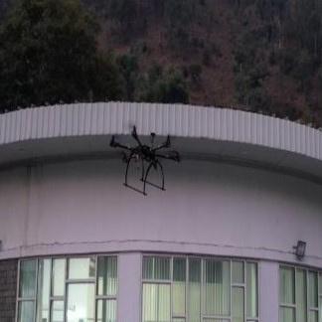

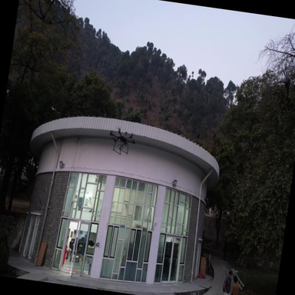
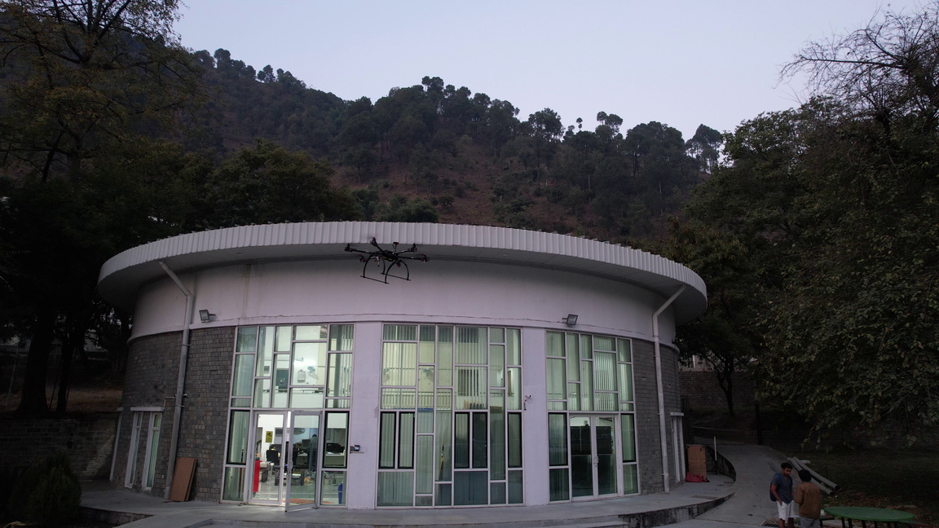
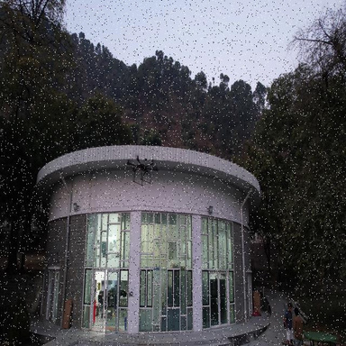
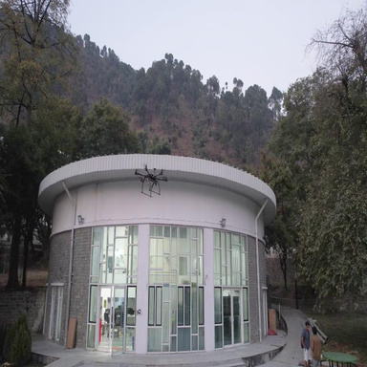
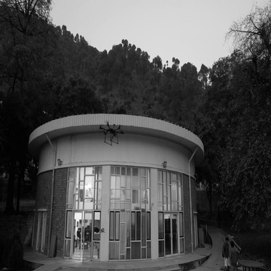
Data Augmentation
Visual Example
30th November
2024
Crop
Blur
20° Rotation
Original Image
Noise
Exposure
Grayscale
10
Source:Self captured

Slide 11
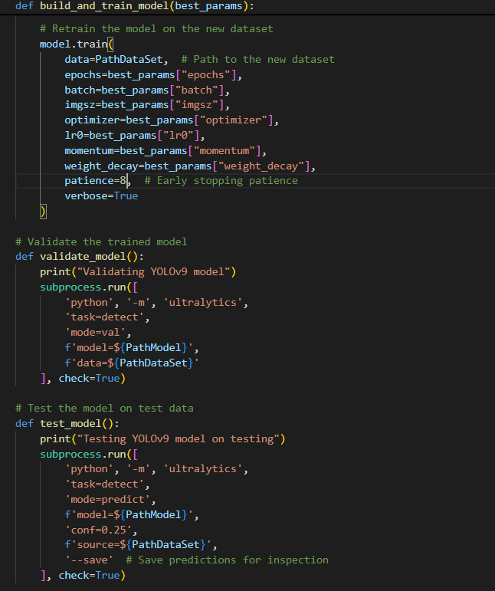
MODEL USED
30th November
2024
YOLOv9
Chosen for its advanced real-time object detection capabilities.
Modified with optimizers and hyperparameter tuning for improved accuracy.
11
2
Source: Self written

Slide 12
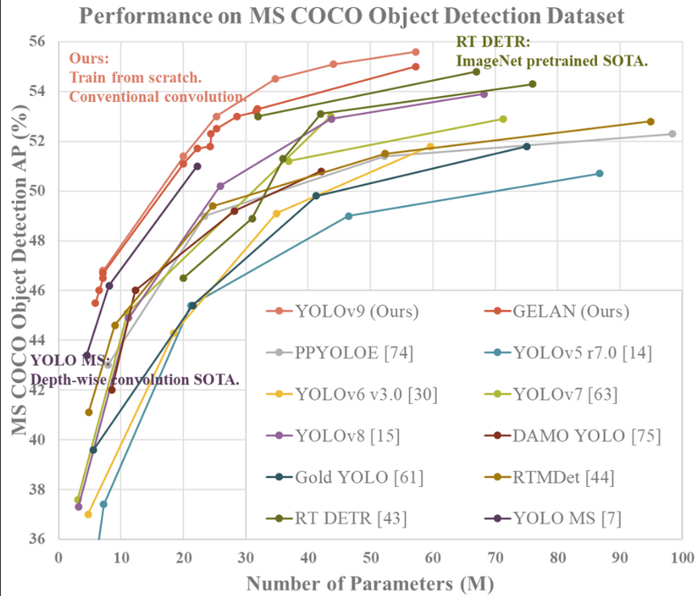
COMPARISON OF YOLO V8 AND YOLO V9
30th November
2024
Accuracy: YOLOv9 is more accurate than YOLOv8 due to architectural improvements and optimizations.
Speed: YOLOv9 has more speed than YOLOv8 for our given number of parameters
12
2
Image Source:https://github.com/WongKinYiu/yolov9

Slide 13
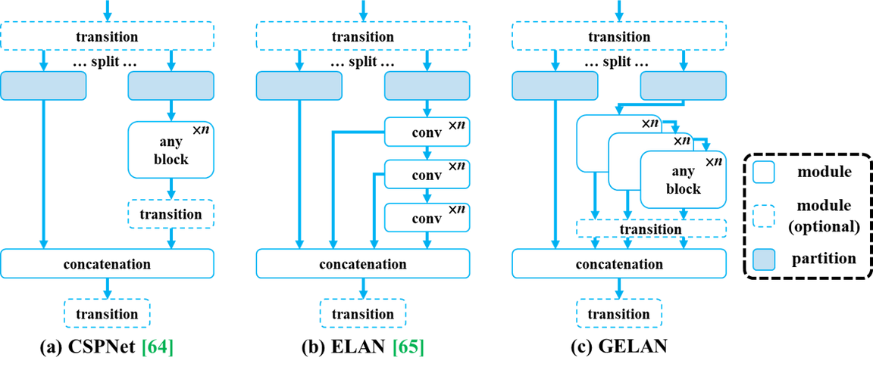
YOLO V9 ARCHITECTURE
In YOLOv9, the GELAN combines the finest qualities of CSPNet's gradient path planning and ELAN's speed optimizations during inference.
GELAN stands as a lightweight framework that emphasizes swift inference while upholding accuracy, thereby broadening the utility of computational blocks.
30th November
2024
Backbone:
CSPNet-based Backbone: Cross-Stage Partial Networks (CSP) enhance gradient flow and reduce computation by splitting the feature map into two parts: one goes through the dense layer, and the other bypasses it.
Neck: The neck aggregates and refines feature maps from the backbone for multi-scale predictions. YOLOv9 uses: Path Aggregation Network, Bi-directional Feature Pyramid Network
Head: The head predicts the class, bounding box, and objectness score for each detected object.
13
2
Image Source:https://arxiv.org/pdf/2402.13616

Slide 14
MODEL TRAINING
Training Workflow
Dataset Preparation:
Dataset split: [70% training, 20% validation, 10% testing].
Preprocessed images fed into the YOLOv8 and YOLOv9 models.
Optimization Techniques:
Optimizers Used: Adam, Adagrad, and SGD to balance speed and accuracy.
Hyperparameters Tuned: Learning rate, epochs, batch size, and weight decay for enhanced performance.
Training Environment:
Platform: Python-based training environment.
Hardware: GPU-enabled PARAM Himalayas used for faster computations.
30th November
2024
14
2

Slide 15
MODEL TRAINING
Challenges
Balancing overfitting and underfitting.
Handling small drone detections amidst background noise.
Outcome
Improved detection accuracy on the custom self-made dataset with promising precision and recall scores.
Both YOLOv8 and YOLOv9 showed significant performance gains after tuning but YOLOv9 was faster as well as more accurate in our case for drone detection so we worked on this one more as compared to other.
30th November
2024
15
2

Slide 16
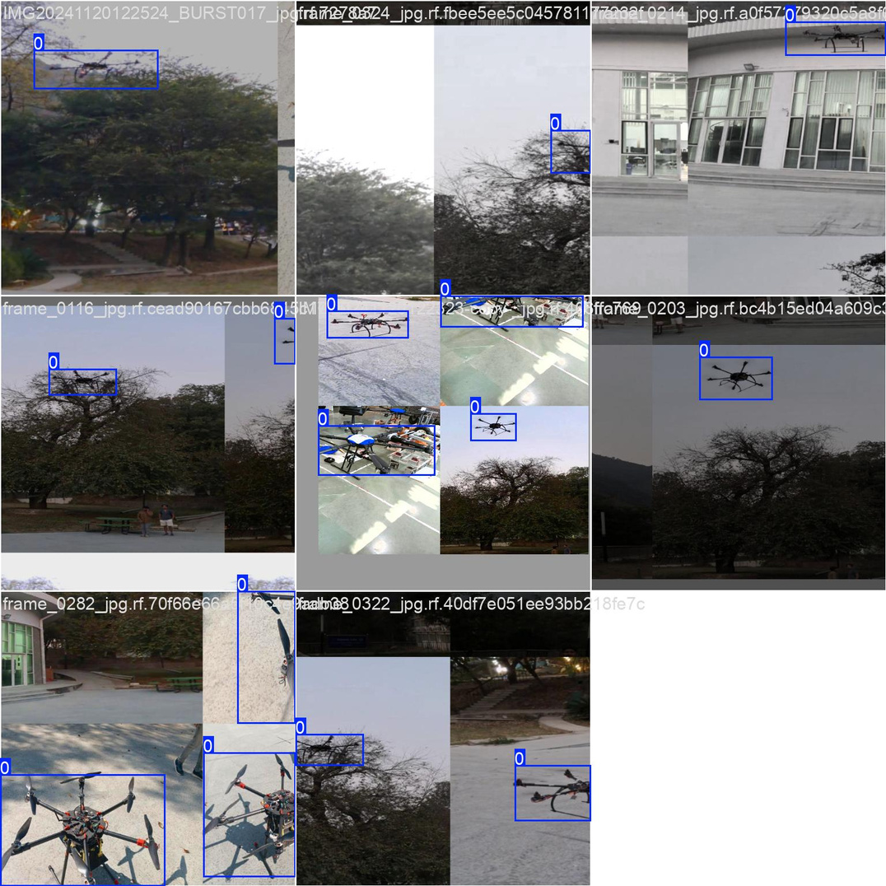
Training Dataset
30th November
2024
16
2
Source: Self Created Dataset

Slide 17
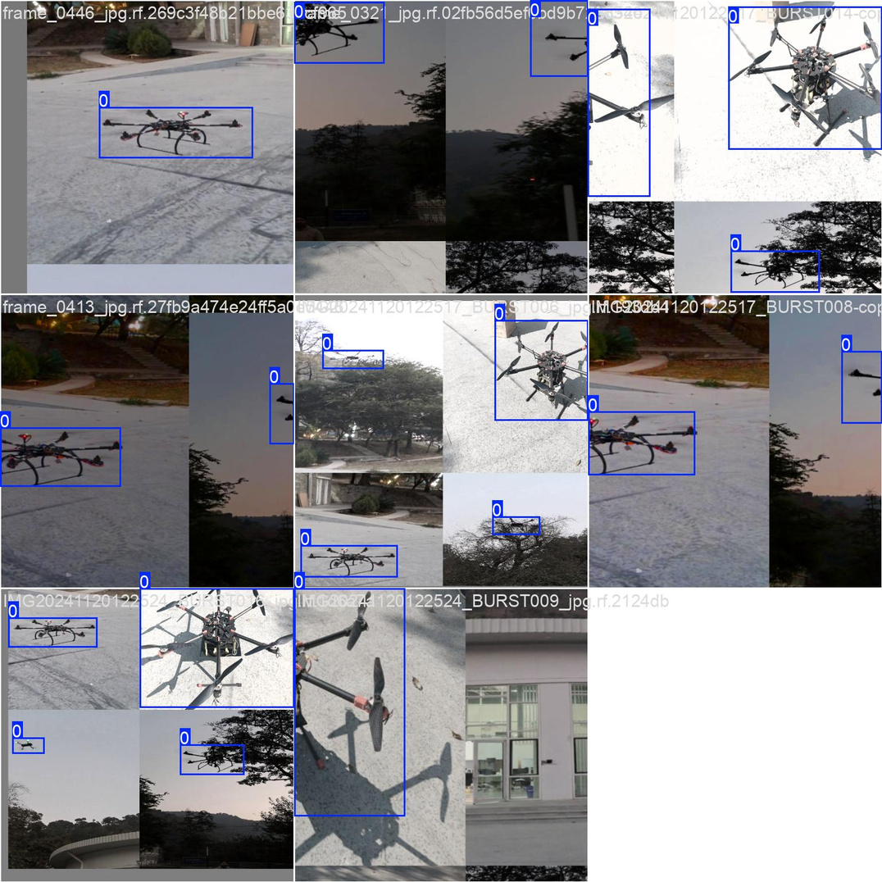
Testing Dataset
30th November
2024
17
2
Source: Self Created Dataset

Slide 18
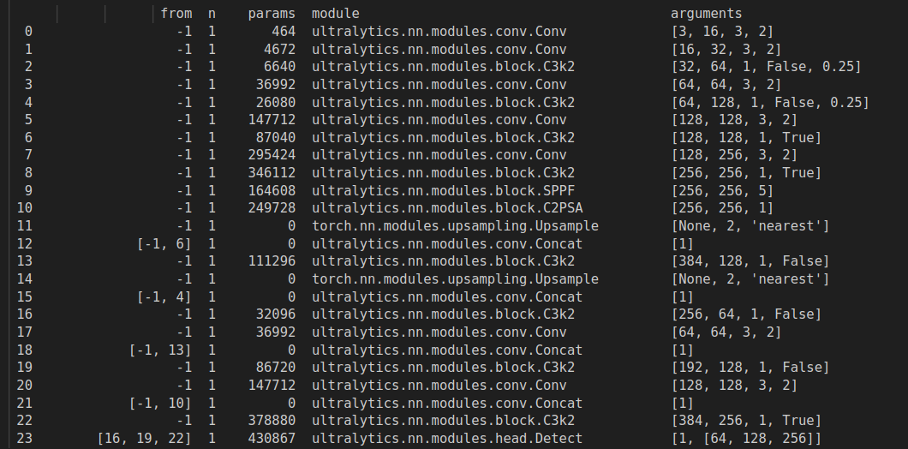
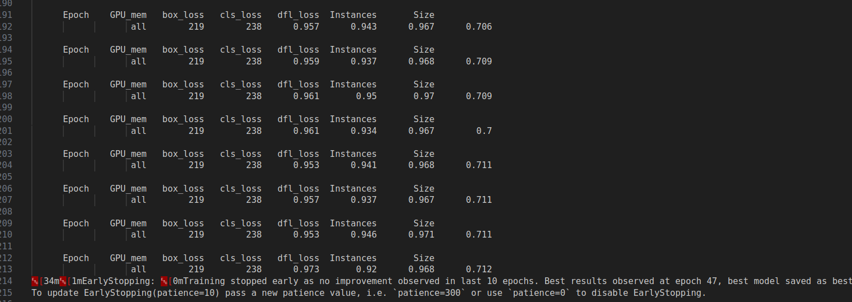
RESULTS AND DISCUSSION
We looked into a few of the models such as yolov8 ,resnet and the yolov9 model.After training the YOLOv9 model, we evaluated its performance using standard metrics such as precision, recall, and confidence. The following sections provide a detailed analysis of the model’s performance, illustrated with relevant curves and a confusion matrix.
30th November
2024
18
2

Slide 19
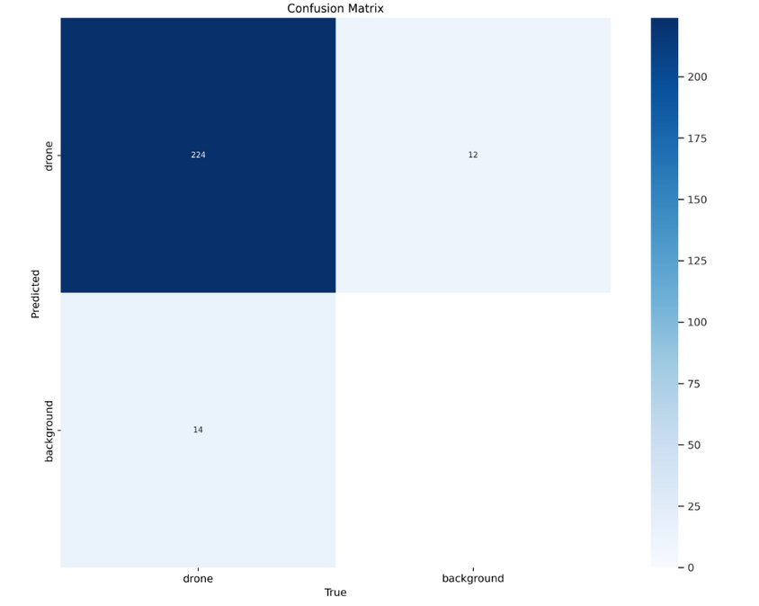
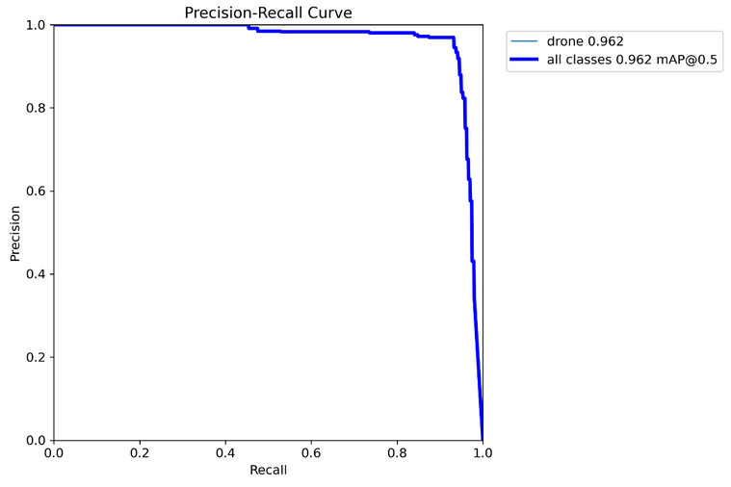
1. Confusion Matrix
True Positives (224): Correctly identified "drone" instances.
False Positives (12): Background misclassified as "drone."
False Negatives (14): Drones misclassified as "background."
True Negatives: Correctly identified "background."
Key Observations:
High True Positives (224) indicate strong performance in detecting drones.
Misclassifications (12 FP, 14 FN) suggest minor improvement areas for reducing false alarms and missed detections.
30th November
2024
2. Precision-Recall Curve
The curve demonstrates that as recall increases, precision drops slightly, indicating the model’s strong performance in detecting objects.
The Precision-Recall Curve illustrates the model's excellent detection performance, achieving a mean Average Precision (mAP) of 0.962 for both the 'drone' class and all classes combined at an IoU threshold of 0.5, signifying its high reliability in minimizing false positives and negatives.
19
2

Slide 20
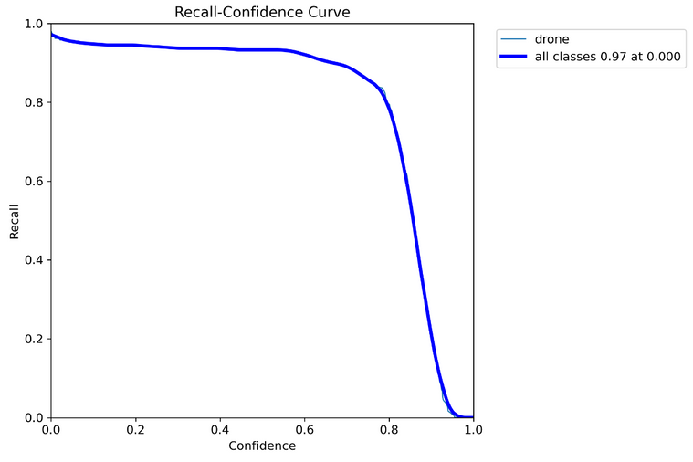
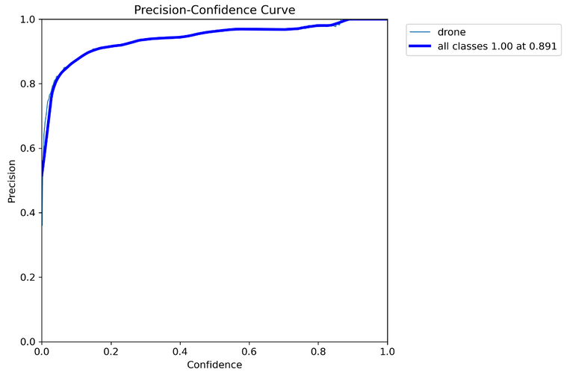
3. Recall-Confidence Curve
Observations:
Flat Start:
The curve starts near a recall of 1, demonstrating that at low confidence thresholds, almost all true positives are detected.
Sharp Decline:
As the confidence threshold increases (towards 1.0), recall sharply decreases, indicating that the model is filtering out predictions it considers uncertain. While this reduces false positives, it also excludes some true positives.
The Recall-Confidence Curve demonstrates the model's ability to detect nearly all true positives (recall = 0.97) at low confidence thresholds. However, as the confidence threshold increases, recall decreases sharply, reflecting the model's balance between sensitivity and prediction certainty. This analysis is critical for optimizing the threshold to suit specific use cases
30th November
2024
4. Precision-Confidence Curve
The precision-confidence curve highlights how precision changes as the confidence
threshold is adjusted. It provides insights into how confident the model is when making
correct detections.
Key Observations from the Curve:
Overall Trend: The curve generally rises from left to right, indicating that as the confidence threshold increases, the precision also increases. This is expected, as higher confidence predictions are more likely to be correct.
All Classes Precision: The blue line represents the precision for all classes combined. It reaches a maximum precision of 1.00 at a confidence level of 0.891. This means that if the model is only considering predictions with a confidence level of 0.891 or higher, it will have perfect precision.
Class-Specific Precision: The light blue line represents the precision for the "drone" class specifically. It follows a similar trend to the overall precision but might have slight variations due to the specific characteristics of the "drone" class.
20
2

Slide 21
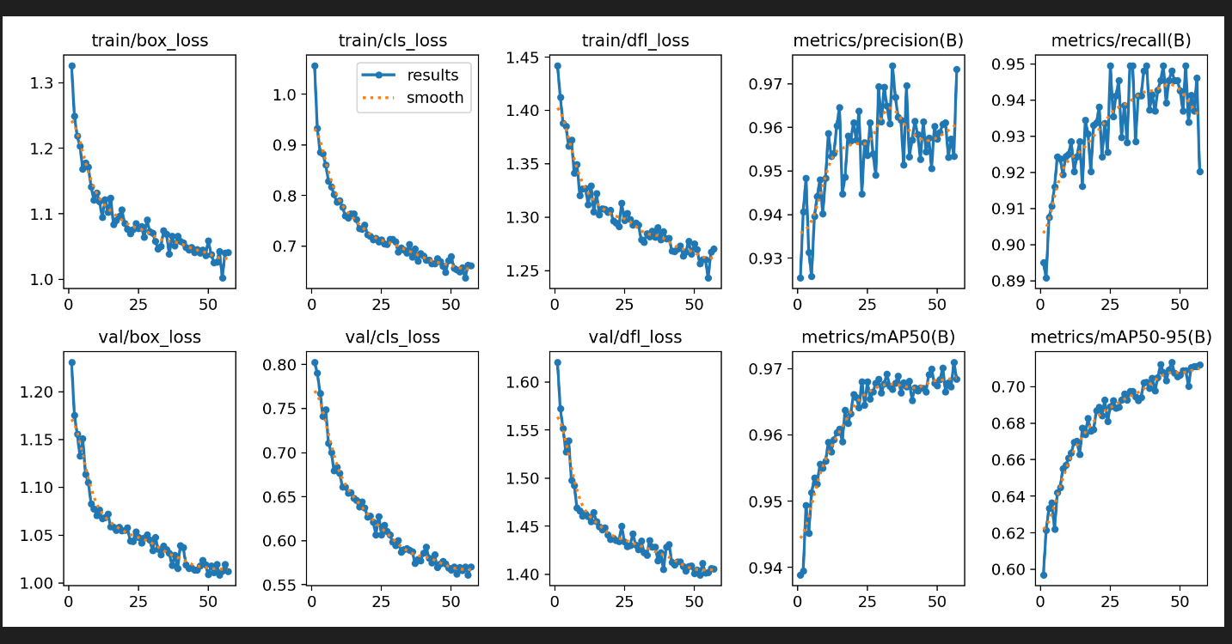
21

Slide 22
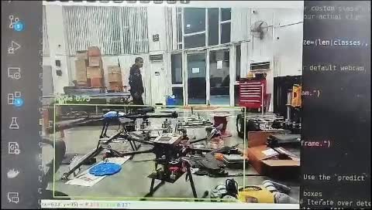
RealTimeDetectionusingcamera
22

Slide 23
CHALLENGES FACED
1. Dataset Challenges
Labeling Complexity:
Manual labeling was time-consuming.
Ensuring consistent and accurate bounding boxes for drone detection.
2. Model-Related Challenges
Detection of Small Drones:
Small drones often blend with the background, leading to missed detections.
Overfitting:
Balancing the model to generalize well across unseen data while minimizing errors.
3. Computational Challenges
Fine-tuning Parameters:
Hyperparameter optimization demanded multiple iterations and time.
30th November
2024
23
2

Slide 24
FUTURE WORK
1. Air-to-Air Neutralization Phase
Develop and implement a neutralization system where one drone intercepts and captures another in mid-air.
Explore various strategies for neutralization, such as:
Deploying nets or mechanical arms for capture.
Disabling the target drone’s systems using electronic methods.
2. Integration of Detection and Neutralization
Combine the detection system with the neutralization mechanism for a seamless, real-time operation.
Ensure accurate synchronization between detection and neutralization drones.
3. Deployment
Test the complete system in real-world environments under varying conditions.
Ensure scalability for practical applications in security and surveillance.
30th November
2024
24
2

Slide 25
Methods of Neutralization
Radio Frequency (RF) Drone Jamming
Disrupts communication between drone and operator.
Laser Systems
Uses high-energy lasers to disable drones.
Killer Drones with Catching Nets
Physically captures drones using nets.
GPS Spoofing
Sends false GPS signals to mislead drones.
High-Power Microwave (HPM) Systems
Emits electromagnetic waves to disable drone electronics.
30th November
2024
25
2

Slide 26
Methods of Neutralization
THE IDEA
Drone Integration with RF Jamming Device
Concept: Mount an RF jamming device onto a neutralizing drone to disable rogue drones in real time through air-to-air interception.
Key Features:
Directional Jamming: Aimed only at the target drone to avoid self-interference.
Frequency Isolation: Neutralizing drone operates on a separate communication frequency (e.g., 5.8 GHz) while the jammer disrupts common drone frequencies (e.g., 2.4 GHz).
On-Demand Activation: The jammer activates only during close proximity to the target to minimize interference.
Advantages:
Technology can be reused or inspected
Effective for disabling drones in real time with minimal collateral damage.
30th November
2024
26
2
Image Source: Internet

Slide 27
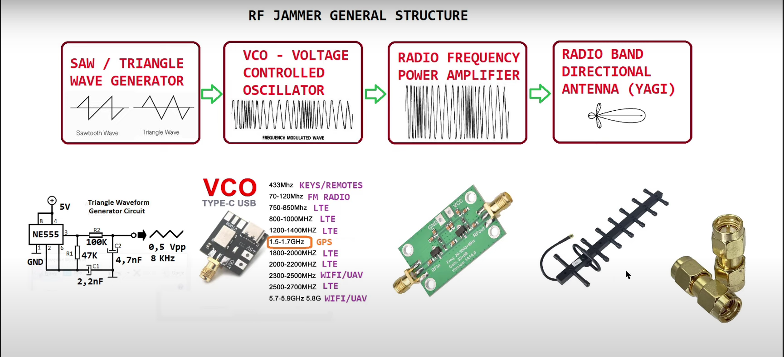
Methods of Neutralization
THE IDEA
30th November
2024
27
2
Image Source: Internet

Slide 28
30th November
2024
Thank you!
Any Questions?
Students
Supervisor
Major
Technical
Project
Dr. Amit Shukla
Ayush Kumar Singh (B21283)
Akash Kumar (B21272)
Atharva Ayanar (B21282)
Ritik Rajput (B21220)
Faculty Advisor
Dr. Prateek Saxena
28

Slide 29
REFERENCES
https://www.sciencedirect.com/science/article/pii/S1570870520306788
https://ieeexplore.ieee.org/abstract/document/9687268
https://yadda.icm.edu.pl/baztech/element/bwmeta1.element.baztech-80829aa7-0db6-4aa6-a09d-d00d0e98430e
https://ieeexplore.ieee.org/abstract/document/9378538
https://ieeexplore.ieee.org/abstract/document/9597861
https://www.ceeol.com/search/article-detail?id=1070586
30th November
2024
29
2

